Slide 1

Website Development: Lesson 1
Facilitated by: Titus Kariuki
Notes:
Web development kahoot

Slide 2
Agenda
1. Introductions & Survey
2. Introduction to Web Development
3. What is HTML/CSS?
4. Q&A
5. Challenge 1: Write a Poem
6. Mastering tags
7. Closing

Slide 3




Who is Titus?
Just graduated from UW
Majored in Mathematics (UW) & Computer Science (from Highline College)
Incoming Business Analyst @ the Bank of New York (BNY) Mellon
The GOAT of NSBE - National Society of Black Engineers
Member of A Vision for Electronic Literacy & Access (AVELA)
Natively Kenyan
Interests: Tech, Finance, Wealth & Investing, Personal Development

Slide 4

Why College?
Wanted to be a Software Architect
Started with an A.S. in Computer Science
…but Java sucked.
Proceeded to do Math
Keeping my options open: tech, finance, business, etc.
Still stay in STEM.
Go on and make money!!!!

Slide 5


What Made College Hard?
Culture shock
I had just landed in the United States
Didn’t know nothing…literally.
Forced to pick myself up.
Learned the system mostly on my own.
Upon transferring to UW, I didn’t have any community. Felt so isolated.
NSBE changed all that.
The rest is history.
NSBE
ME

Slide 6

Introduce yourselves!
Name
Grade
Why you’re in this class
Favorite TV/movie villain and why

Slide 7

Questions for Us?

Slide 8


Before we get started,...
Thanks so much for being here today! To help us better support you and make sure you have a great experience, please fill out this quick survey before the fun begins.
And just a reminder, it’s anonymous!!

Slide 9
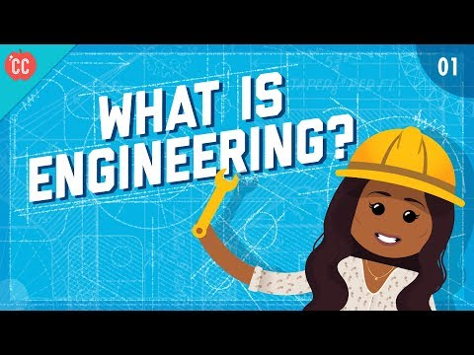
What is Engineering?
Let's first talk about what Engineering is…
Definition: The branch of science and technology concerned with the design, building, and use of engines, machines, and structures
Notes:
Stop video at 4 minutes

Slide 10
What are some examples of engineering companies?
What problems do they solve?

Slide 11

What is Computer Science and Web Development?
Let's first talk about what Computer Science and Web Development are…..
Definitions:
Computer Science is the study of computers and computational systems to design and analyze algorithm to solve problems.
Web development is the work involving building creating, and maintaining websites on the world wide web or private networks

Slide 12
Careers in Web Development
Education
Masters or doctorate degree (3-5 more years after bachelors)
Builds research skills and trains in advanced concepts
Accelerated introduction to field
Prices range $1,000-$15,000 for 3-9 months
Four years at an accredited institution
Meets the requirements are almost all entry level jobs
Certificate Programs
Bachelor’s Degree
Graduate Degree

Slide 13
Careers in Web Development
Job Market
Write and test code for computer operations to function
Average salary: $89,190
Education needed: Bachelor's degree
Create images and elements that end up on screen
Average salary: $77,200
Education needed: Bachelor’s degree
Organizing information for analysts and consumers
Average salary: $98,860
Education needed: Bachelor’s degree
Digital Designer
Database Administrator
Computer Programmer
Notes:
Bureau of labor statistics

Slide 14
Kahoot!
Notes:
Kahoot link: https://create.kahoot.it/share/website-development/c7896c1f-7eef-4cb8-bbe1-086b027fe010

Slide 15
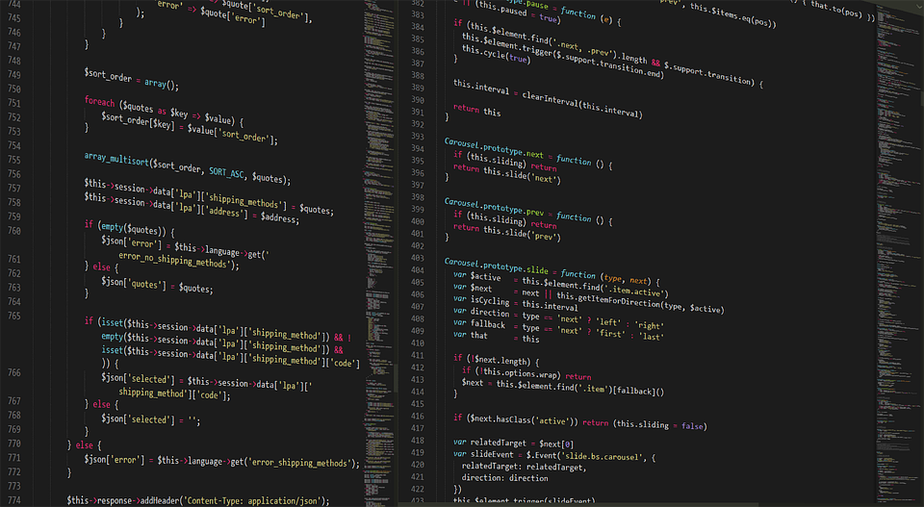
We will work individually (or in teams if you prefer) to create personal websites about our hobbies using HTML and CSS coding

Slide 16
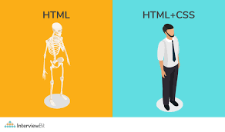
What is HTML/CSS?
HTML
CSS
HTML: HyperText Markup Language
Computer language that is most used for creating web pages
CSS: Cascading Style Sheet
Computer language that describes the look of web pages using colors, layout, fonts, and design

Slide 17
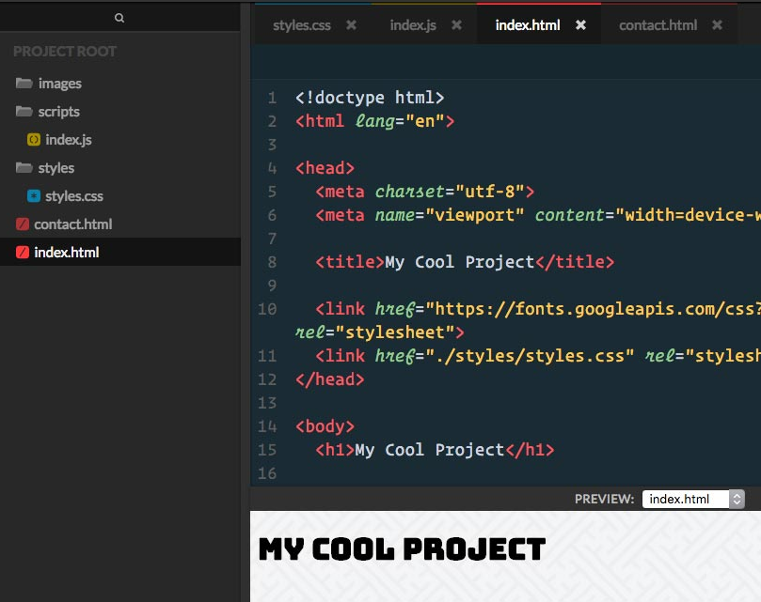
Coding HTML
It’s easier than it looks!!!
To code an html webpage, you can either use a notepad application or an online IDE
An IDE is an Integrated Development Environment
(a place for coding)

Slide 18
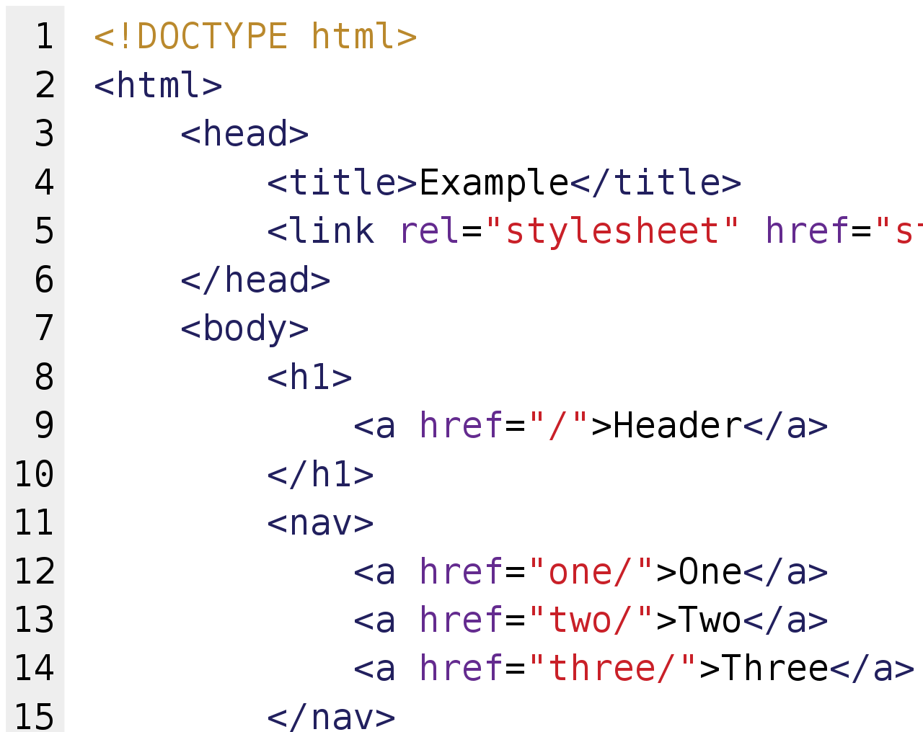
Coding HTML
Writing HTML: setting up the web browser to understand what language you’re using
<!DOCTYPE html>
<html>
<body>
.
.
.
</body>
</html>

Slide 19
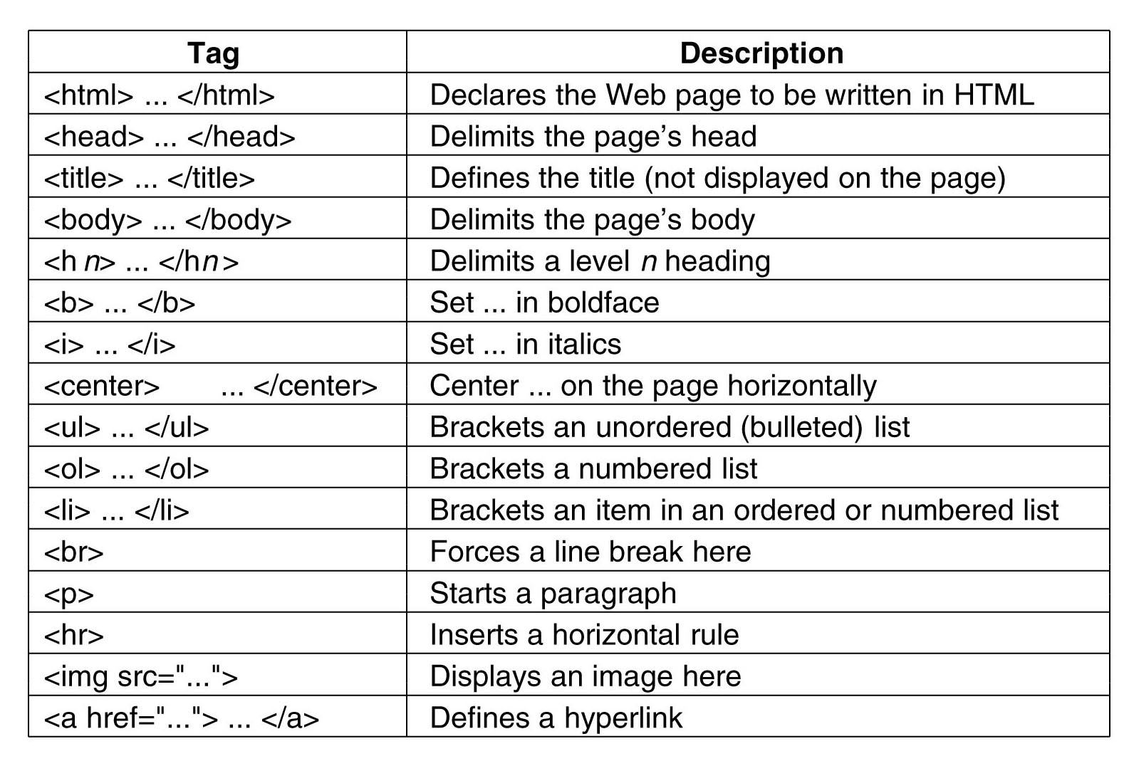
Coding HTML (Syntax)
Syntax Definition:
Set of rules that define the structure of a language
The grammar of your coding language
HTML is mainly comprised of tags
Tags are placed in the beginning and end of information to define the characteristics of the element
Elements define the style of the text it encloses (e.g. title, body, footer, etc.)

Slide 20
Coding HTML (Syntax)
For today’s challenge we will be focusing on:
<!DOCTYPE HTML>
<html>
<head>
<title>
<meta charset>
<body>
<h>
<p>

Slide 21
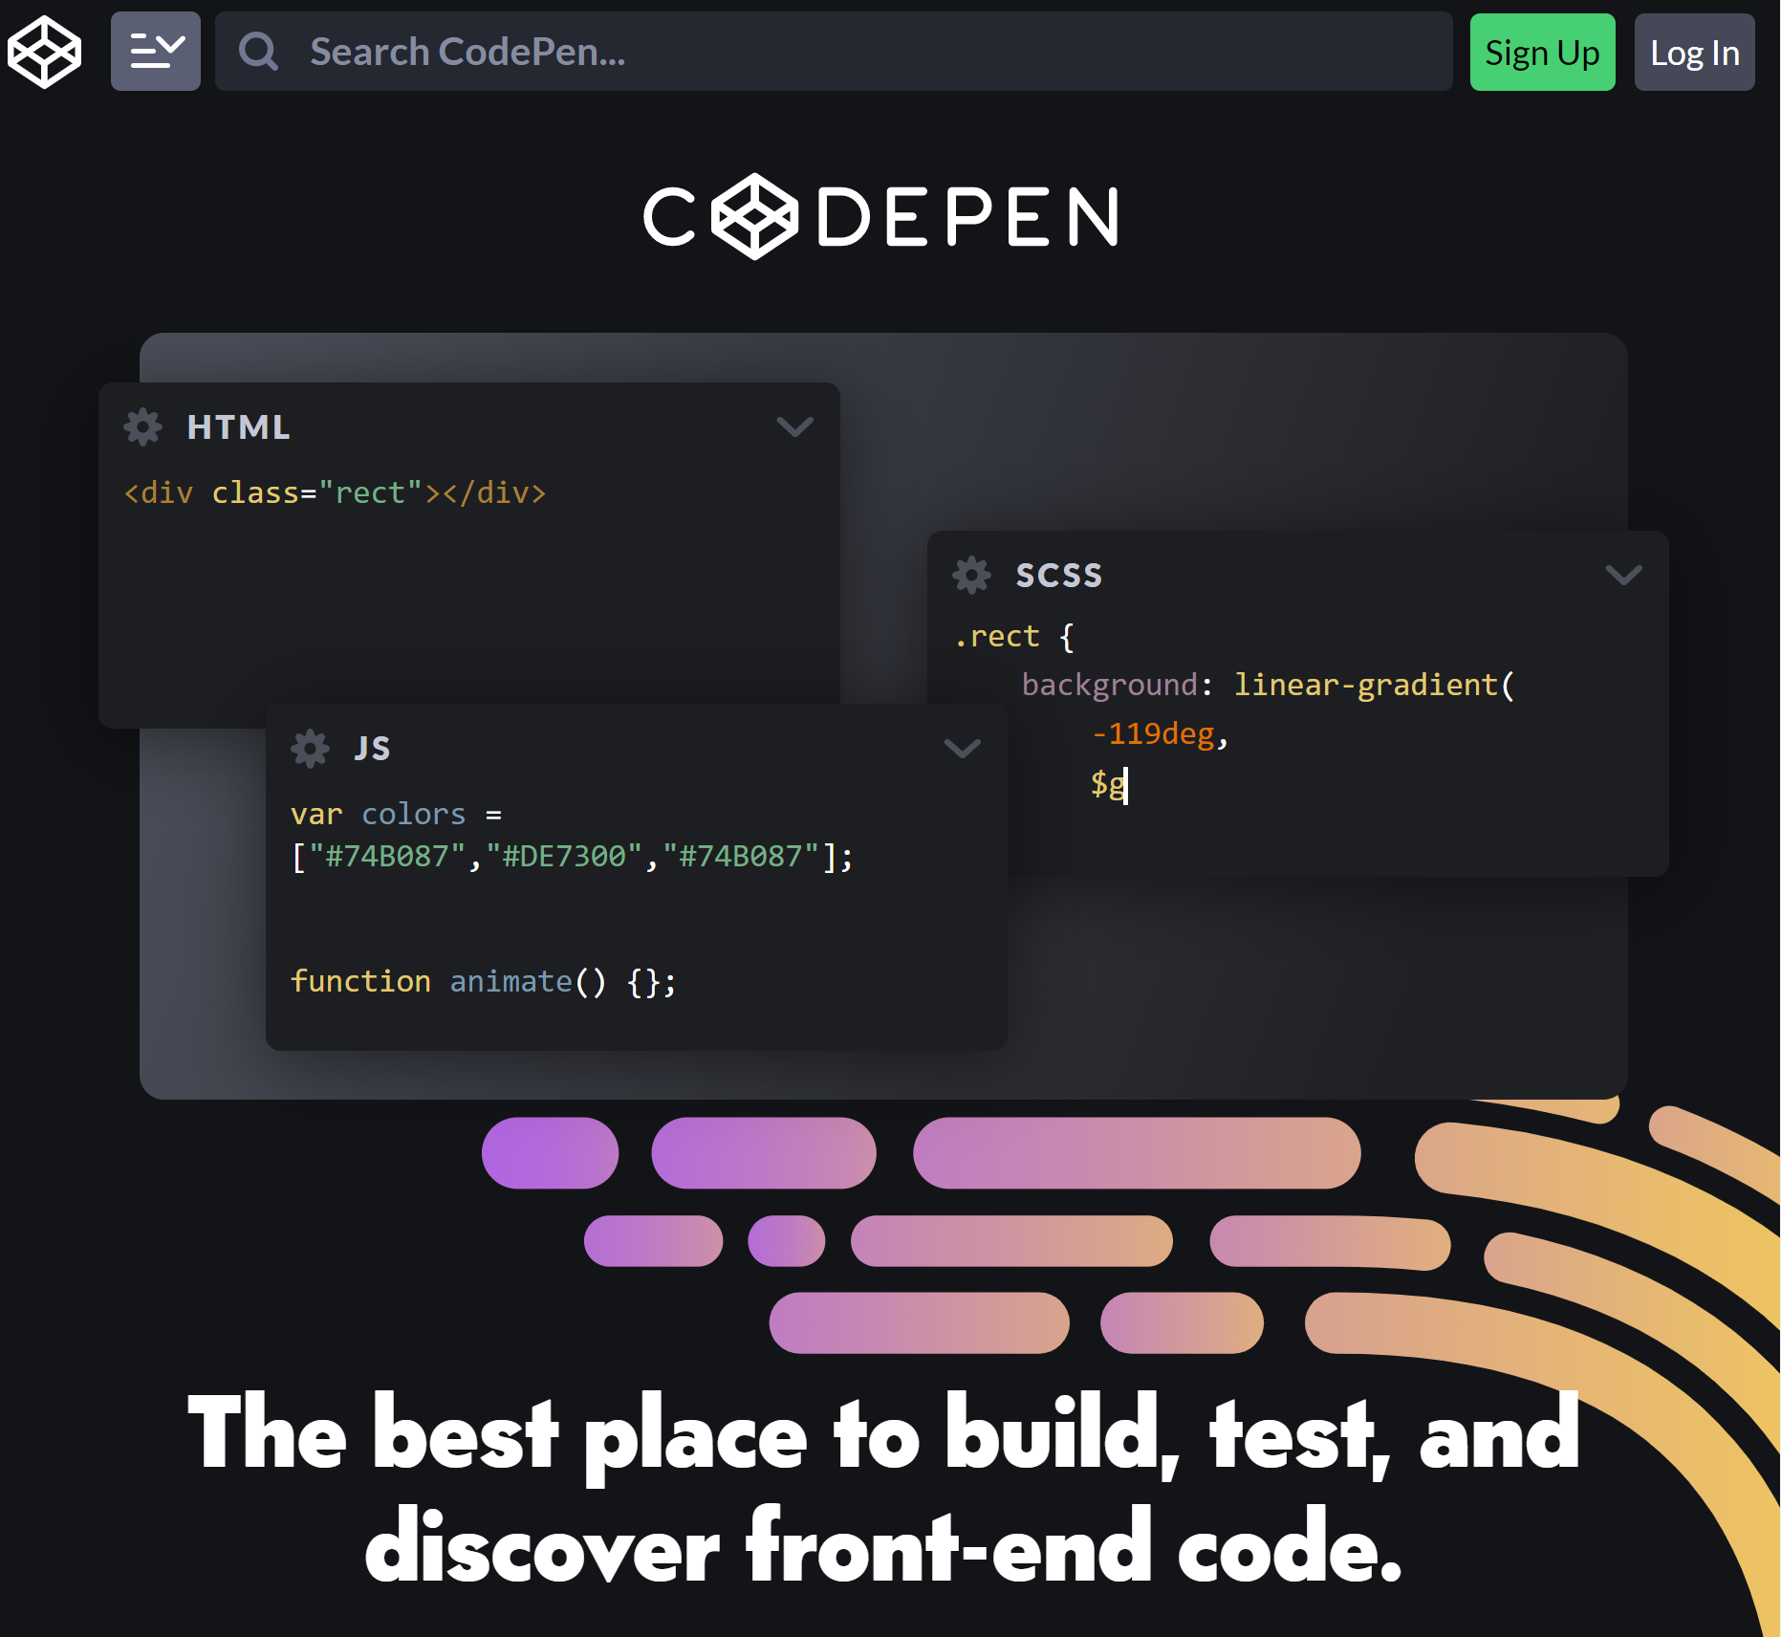

CodePen
What is CodePen?
Codepen is the software that we will be using for the next 4 weeks.
The advantages of using codepen are that you can keep all of your work in one place and work on multiple projects on your own.
This is the Link —-> https://codepen.io/accounts/signup/user/free
Set up:
Create an account (Free!)
Then you are ready!
Hit this button on the top right. —>
Notes:
https://codepen.io/accounts/signup/user/free

Slide 22
Questions?

Slide 23
Mastering HTML Tags
What are HTML tags?
HTML tags are a piece of markup language placed at the beginning and end of an element to give it certain characteristics
Tags go around every element and can also be placed within an element
Whatever is opened must be closed (just like parenthesis)
<> to open
</> to close

Slide 24
Document Tags
Tags necessary for this challenge (document tags):
<!DocType>
MUST HAVE!
<html> </html>
The root of an HTML document
<meta charset=”.....”>
Encoding the HTML document

Slide 25
Text Tags
Tags necessary for this challenge (text tags):
<body> </body>
The content of an HTML document is contained in this element (Vase)
<h1> </h1>
One example of a header (Flower)
<p> </p>
Paragraphs (Soil)

Slide 26
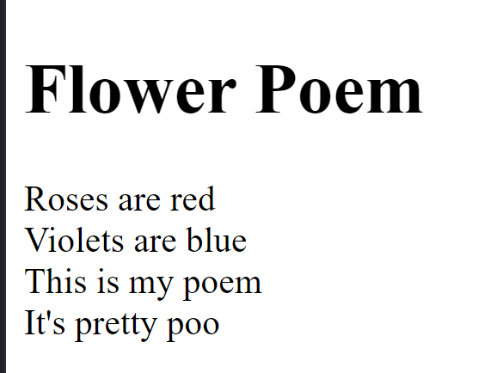
Challenge 1: Write a Poem
Write a poem online using your new html skills

Slide 27
Questions?

